Slide 1
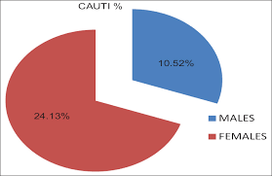
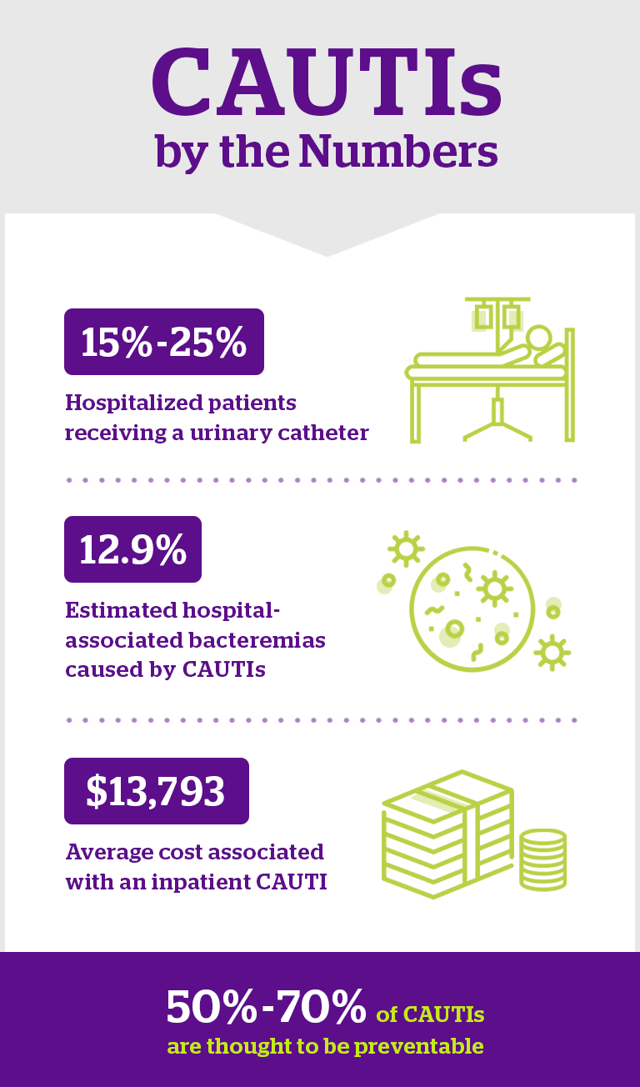
Reducing Catheter Assoicated Urinary Tract Infections by using External Catheters
Introduction
Urinary Tract infections are among the most common healthcare-associated infection, and 70%-80% are catheter associated urinary infections (CAUTI). 25% of hospitalized patients have indwelling catheters placed during their hospital stay, and therefore, are at risk for CAUTIs which have been associated with worse patient outcomes. In 2016, 26,983 CAUTI’s occurred in acute care hospitals. These infections contribute to morbidity, length of stay, and mortality.
Research Question
For patients admitted in an acute hospital setting does the use of alternative external urinary collection devices reduce the future risk of catheter associated urinary tract infections compare with indwelling catheters?
Purpose
The purpose of this research is to reduce catheter associated urinary tract infection risk for female patients by implementing a female external urinary collection device with suction as an alternative to indwelling catheters and using condom catheters for males to reduce the risk of UTI when using an indwelling catheter.
Lindsey Bollig, RN
Fort Hays State University, Department of Nursing
Conceptual Framework
Theorist Nola Pender developed her Health Promotion Model (HPM), after seeing professional intervening only after patients developed acute or chronic health problem. She became convinced that patients’ quality of life could be improved by the prevention of problems before this occurred, and healthcare dollars could be saved by promotion of healthy lifestyles.
Methods
Reducing CAUTIs by using external female catheters and by using condom catheters in men. Baseline data for all inpatient CAUTIs, foley utilization rate and standardized infection rates analyzed and compared before and after implementation of the external catheter option. Excluded patient from this method would be patients that are not cooperative, patients with urinary retention, or bladder obstructions. All other patients using or needing catheters can be included.
Results
External catheters are a feasible alternative to an indwelling catheter. It should be considered for prevention of CAUTIs. It allows for ongoing monitoring od continuous output, aids in the provision of patient dignity, helps keep patients safe from infection and reportedly, improves nurse satisfaction. Patients also reported a sense of cleanliness, increased comfort by staying dry and less linen changes leading to reduction in pain and discomfort.(Beeson, 2019)
A study compared indwelling catheters to external catheter devices in 75 men aged 40yrs or more who required urinary drainage during hospitalization. Men that had the external catheter had a lower incidence of bacteriuria than did men randomized to the indwelling catheter group. (Gray, 2016)
According to the CDC’s National Healthcare Safety Network data revealed a drastic improvement of 51.7% in CAUTI reduction with the use of external catheters.
Implications for Nursing
Hospital acquired infections are a continued challenge in hospitals. It’s easy to put an indwelling catheter in a patient and just leave it in for convenience instead of necessity. If the patient has to have a catheter it would be beneficial to the patient and the hospital to use an external catheter to reduce the chance of getting an infection from that indwelling catheter. Studies have shown that the patient and the nurses like them more, they are more comfortable and have shown to reduce the percentage of CAUTIs.
Clarke, K., Hall, C., Wiley, Z., Kim, J., Reif, L. (2019). Catheter-Associated Urinary Tract Infection in Adults: Diagnosis, Treatment and Prevention. Journal of Hospital Medicine. Doi 10.12788/jhm.3292
Benson, T., Davis, C. (2018). Urinary Management with an External Female Collection Device. J Wound Ostomy Continence Nurs. 45(2). 187-189. Doi 10.1097/WON.0000000000000417
Dublynn, T. RN, Episcopia, B. RN.(2019). Female External Catheter Use: A New Bundle Element to Reduce CAUTI. American Journal of Infection Control. 42(6). 39-40. Retrieved from http://www.sciencedirect.com/science/article/abs/pii/S0196655319303219
Eckert, L., Mattia, L., Patel, S., Okumura, R., Reynolds, P., Stuiver, I. (2020). Reducing the Risk of Indwelling Catheter-Associated Urinary Tract Infections in Female Patients by Implementing an Alternative Female External Urinary Collection Device. J Wound Ostomy Continence Nurs. 47(1) 50-53. Doi 10.1097/WON.0000000000000601
Gray, M., Skinner, C., Kaler, W. (2019). External Collection Devices as an Alternative to the Indwelling Urinary Catheter. J Wound Ostomy Continence Nurs. 43(3). 301-307 Doi 10.1097/WON.0000000000000220
Saint, S., Krein, S., Fowler, K., Colozzi, J. (2020). Condom Catheter versus Indwelling Urethral Catheters in Men: A Prospective, Observational Study. Journal of Hospital Medicine. Doi 10.12788/jhm.3180

