Slide 1
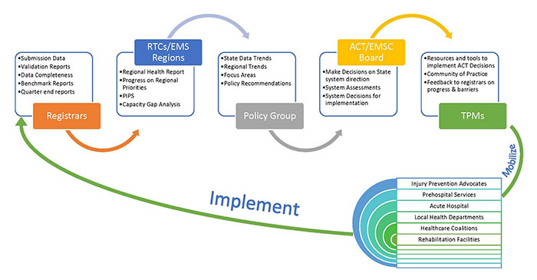
BENEFITS AND IMPORTANCE OF BECOMING A LEVEL 4 TRAUMA CENTER
Christina M Sare, RN, FHNS
Fort Hays State University, Department of Nursing
Nursing Implications:
Being designated a Level 4 Trauma center requires staff to be educated on trauma activation and trauma courses which promotes enhanced education. Having the credentialing promotes rapport with larger trauma centers that will be accepting transfers of patients. This in turn gives a higher level of trust between hospitals which makes the transfer process more time effective and results in better patient outcomes.
Introduction:
The effect of Level 4 trauma centers on patient outcomes is understudied (Vernon et al., 2019). Along with better patient outcomes a Level 4 accreditation can have meaningful financial advantages, promote process improvements, help with physician and surgeon recruiting and retention, and improve overall service ( Kansas Department of Health and Environment, 2020).
Methods:
A Pennsylvania trauma system collected data from 5 hospitals pre to post designation of level 4 credentialing from 2012-2017 using a multi level mixed effect logistic aggression model.
Results:
There was a trend toward reducing the odds of mortality post credentialing and decrease in major surgical interventions needed post credentialing. Overall level 4 accreditation increased transfers and decreased mortality rates.
Research Question:
In rural healthcare communities what is the effect of having a level four trauma center on patient care and outcomes compared to having a critical access hospital or non trauma center?
Steps for implementing and documenting level 4 trauma activation
References:
Vernon, t. M., Cook, A. D., Horst, M. A., Gross, B. W., Bradburn, E. H., Jammula, S., Altenburg, J., Bradley, D., & Rodgers, F. (2019). A preliminary analysis of Level IV trauma centers within an organized trauma system. Journal of Trauma and Acute Care Surgery, 87(3), 666-671. https://doi.org/10.1097/TA.0000000000002383
Kansas Department of Health and Environment. (2020, January 28). Welcome | Kansas State Legislature. https://kslegislature.org/li/b2019_20/committees/ctte_h_rural_revitalization_1/documents/testimony/20200128_02.pdf
Wayne, G. (2020, January 2). Nursing theories and theorists: An ultimate guide for nurses. Nurseslabs. https://nurseslabs.com/nursing-theories/#list_of_nursing_theories_and_theorists
Conceptual Framework:
Marilyn Anne Ray’s Theory of Bureaucratic nursing would be related to this topic because it presents the different views as to how the healthcare organization relates as whole and parts of the healthcare system (Wayne, 2020).

