Slide 1
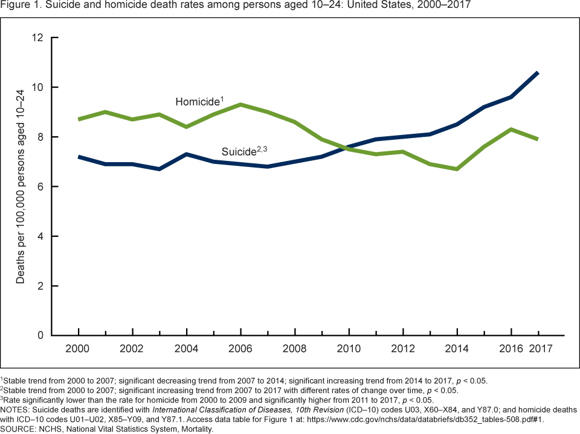
Too Young for Suicide
Amanda Lakin
NURS 446
Introduction
Conceptual Framework
Results Continued
Adolescent suicide rates are a public health emergency. Rates continue to rise. According to the CDC, suicide is the second leading cause of adolescent death, drastically increasing threefold for ages 10-14, and increasing by 76% for 15-19-year-olds between 2007-2017. (Curtin, 2019)
Phil Barker’s Tidal Model is the “philosophical approach to the discovery of mental health” (Tidal Model, 2015). The Tidal Model can be used to assist the patient on the road to recovery by helping the patient to realize the power of change lies within them. This framework gives the patient a voice.
One study showed over a 60% rate of identification of suicide risk and provided immediate interventions when the Columbia-Suicide Severity Rating Scale (C-SSRS) and the Patient Health Questionnaire-9 (PHQ-9) were used. (Hooper, 2019)
A second study found that screening was able to identify adolescents at high risk even when mental health was not the reason for the visit. (Patel, 2018)
A third study found that over 28% of adolescents who had a positive suicide screen were also positive for depression. (Ferrin, 2019)
Research Question
For adolescents, what is the effect of a standardized screening tool on early identification of suicide risk compared to no standardized assessment screening tool?
Methods
Must discuss adolescent mental health
Must use standardized screening tools
Must measure effectiveness of screening
Purpose
To determine if using a screening tool helps in the early identification of suicide risk in adolescents and decreases suicide attempts.
Results
Nursing Implications
The use of standardized screening tools in clinical settings can improve early detection of suicide risk in adolescent patients. This early detection can lead to mental health interventions and a decrease in suicide attempts.
Nurses are uniquely positioned to screen adolescents during initial assessment.
Nurses are able make immediate interventions and referrals as needed.
Nurses are well positioned to follow-up with the patients and develop a trusting relationship.
References
Barker, P. (2015). Tidal Model. http://www.tidal-model.com/
Curtin, S., & Heron, M. (2019, October). Death Rates Due to Suicide and Homicide Among Persons Aged 10–24: United States, 2000–2017. Centers for Disease Control and Prevention. https://www.cdc.gov/nchs/products/databriefs/db352.htm
Ferrin, S. N., Shan, M., Garbuz, T., & Aalsma, M. C. (2019). 136. Suicide Screening And Intervention Among Adolescents In The Primary Care Setting...SAHM Annual Meeting, Psychological Well-Being: International Transcultural Perspectives, March 6-9, 2019, Washington, DC, USA. Journal of Adolescent Health, 64, S70–S71. https://doi-org.ezproxy.fhsu.edu/10.1016/j.jadohealth.2018.10.152
Hooper Weatherly, A. (2019). Effectiveness of Two Psychiatric Screening Tools for Adolescent Suicide Risk. Pediatric Nursing, 45(4), 180–183.
Patel, A., Watts, C., Shiddell, S., Couch, K., Smith, A. M., Moran, M. J., & Conners, G. P. (2018). Universal Adolescent Suicide Screening in a Pediatric Urgent Care Center. Archives of Suicide Research, 22(1), 118–127. https://doi-org.ezproxy.fhsu.edu/10.1080/13811118.2017.1304303

