Slide 1
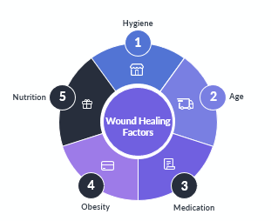
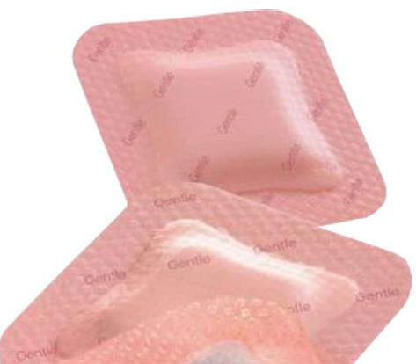
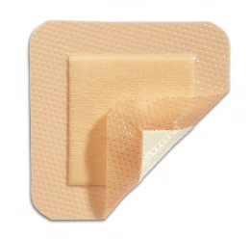
What’s the Best Wound Care Dressing for Healing Stage II Pressure Ulcers?
Duke Onkoba Ondieki, RN, FHNS
Fort Hays State University, Department of Nursing
Introduction
Pressure ulcers cause a lot of pain and suffering to patients and can significantly decrease their quality of life. In addition, the cost of treating pressure ulcers can be considerable. Numerous clinical guidelines recommend hydrocellular dressings for treatment of non-infected stage II pressure ulcers in adults. There is no clear evidence on the effect of hydrocellular dressings on healing time compared with the standard dressings.
Research Question
"In adult patients with stage II pressure ulcers, what is the effect of hydrocellular dressings on healing time compared with the standard dressing?"
Purpose
The purpose of the study was to compare the efficacy and healing time of hydrocellular dressings compared with other standard dressings for treating non-infected stage II pressure ulcers.
Implications for Nursing
The choice of a dressing for treating a specific wound can be a daunting task for a nurse due to the overwhelming number of different dressing options that are currently available. Its common practice for the nurse to just use a dressing that the physician recommended or use an alternative dressing that is readily available or one that they have always used for that type of wound. This article provides some evidence-based information that a nurse can use to select the most effective dressing for treating a stage II pressure ulcer.
Methods
The method uses was a systematic review. Five electronic databases were searched (from 2015 to 2020) for published studies that addressed the efficacy and healing time of hydrocellular dressings compared with other standard dressings for treating pressure ulcers. For inclusion, patients were required to be older than 18 years-old and have pressure ulcers. Patients were excluded if their pressure ulcer was not treated with a wound care dressing.
Results
Wound care dressing fosters a protected environment that can facilitate the wound healing. “The main functions of a dressing are to absorb exudate, prevent infection, splint the wound area, and for psychological comfort” (Rogers, 2017).
There is no conclusive evidence that shows which type of dressing will be most effective in treating all stage II pressure ulcers. “There is no one type of dressing to suit every patient, even those with a similar type or stage of wound. To select the most appropriate dressing / treatment, it is vital that comprehensive holistic wound assessment also considers the patient's preferences. Healthcare professionals should always work with patients to ensure that care remains centered on the individual” (Nazarko, 2018).
The efficacy of hydrocellular dressing compared to other standard wound care dressings is unclear.
References
Chamorro, A., Vidal Thomas, M., Mieras, A., Leiva, A., Martínez, M., & Hernández Yeste, M. (2019). Multicenter randomized controlled trial comparing the effectiveness and safety of hydrocellular and hydrocolloid dressings for treatment of category II pressure ulcers in patients at primary and long-term care institutions. International Journal of Nursing Studies, 94, 179-185.
Gonzalo, A. (2019, August 22). Florence Nightingale’s Biography and Environmental Theory: Study Guide. Nurseslabs. https://nurseslabs.com/florence-nightingales-environmental-theory/
Rogers, L. (2017). A Simplified "How to" on Prescribing Wound Dressings for Home Use: The choice of the proper dressing can facilitate faster healing. Podiatry Management, 36(9), 91.
Nazarko, Linda. (2018). Choosing the correct wound care dressing: An overview. Journal of Community Nursing, 32(5), 42,44-46,48,50-52.
Souliotis, K., Kalemikerakis, I., Saridi, M., Papageorgiou, M., & Kalokerinou, A. (2016). A cost and clinical effectiveness analysis among moist wound healing dressings versus traditional methods in home care patients with pressure ulcers. Wound Repair and Regeneration, 24(3), 596-601.
Mölnlycke Mepilex® Border Lite Foam Dressing. (n.d.). Bowers Medical Supply. Retrieved March 11, 2020, from https://www.bowersmedical.com/online-catalogue-product/molnlycke-mepilex-border-lite-foam-dressing/
Allevyn Gentle Border Lite Foam Dressing | Allevyn Lite. (n.d.). Www.Healthproductsforyou.Com. Retrieved March 11, 2020, from https://www.healthproductsforyou.com/p-smith-nephew-allevyn-gentle-border-lite-silicone-gel-adhesive-hydrocellular-foam-dressing.html
Conceptual Framework
Wound dressings are used to cover and protect the wound from the external environment and infectious agents while maintaining an adequate exchange of gases. Florence Nightingale’s Environmental Theory will be the most appropriate foundation for the research. “It involves the nurse’s initiative to configure environmental settings appropriate for the gradual restoration of the patient’s health, and that external factors associated with the patient’s surroundings affect life or biologic and physiologic processes, and his development” (Gonzalo, 2019)..
Factors that Promote Wound Healing
Allevyn Lite. (n.d.)
Bowers Medical Supply, (n.d.)

