Slide 1
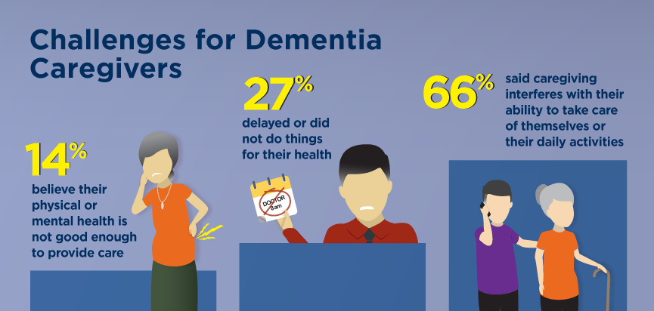
Caring for Dementia: A Universal Occupation
Author’s Name: Karlene A Pryce, RN
Fort Hays State University, Department of Nursing
Introduction
When family caregivers lack adequate training to care for older adults with cognitive impairment and are faced with new acute illness or behavior problems, the patients have a hard time expressing their feelings and the caregivers do not know when to seek professional medical assistance.
Research Question
For family caregivers of older adults with cognitive impairment, what is the effect of a standardized training program about identifying acute illnesses on prompt communication of symptoms to patient-care providers compared to no standardized training program?
Methods
A systematic review was collected to see what strategies were needed for caregivers and individuals living with cognitive impairment. The main purpose of the review was family caregivers’ lack of knowledge, formal training, coping, and problem solving. Six studies were obtained, all of which acknowledged the importance of educating family caregivers of individuals with cognitive impairment. The first study (Steis et al., 2019) used a retrospective chart review, including patients with Alzheimer’s disease, dementia, and other cognitive impairment with supportive family caregivers. The second study, by Sousa, Sequeira, and Ferre´-Grau (2018), included main caregivers of individuals with dementia and nurses for 3 years or more. The study used an online questionnaire through Google docs. The third study (Morris, Horne, McEvoy, & Williamson, 2018) used electronic databases (i.e., CINAHL plus, MEDLINE, PsycINFO). The study aimed at professional families with dementia. The fourth study (Heinrich et al., 2016) used 13 dementia-care networks in different states of Germany. The interviews were audiotaped and transcribed. The fifth study, by Mehta et al. (2018), used an online e-book to provide education about dementia and caregivers and analyzed the effectiveness of online self-help.
Results
The systematic review validated the concept that training programs for family caregivers of individuals with cognitive impairment are vital. The effective intervention and communication will help caregivers to achieve their goals. Technology also improves communication among healthcare professionals, family caregivers, and patients. In a study in Sweden, Lundberg and colleagues initiated an integrated internet videophone system that gives information and social support to family caregivers. Although all five studies acknowledged that effective intervention and training allowed caregivers to perform better care, two studies showed that further research is required.
Implications for Nursing
Cognitive impairment is a major health issue throughout the world. My facility is targeting cognitive impairment in many ways. Although we care for these individuals within the facility, there comes a time when family members need to spend time at home with their loved ones. Because these patients are at high risk for injury and other acute illnesses, we provide caregivers with safety information on how to monitor and assess patients according to their illnesses or diseases. For example, a patient might have increased confusion due to a urinary-tract infection or a patient becomes dizzy and shaky due to hypoglycemia. These are some of the signs and symptoms, in addition to other safety measures, on which we educate family members.
Knowledge
goal
Knowledge evaluation
References
Heinrich, S., Uribe, F. L., Roes, M., Hoffmann, W., Thyrian, J. R., Wolf-Ostermann, K., & Holle, B. (2016). Knowledge management in dementia care networks: A qualitative analysis of successful information and support strategies for people with dementia living at home and their family caregivers. Public Health, 131, 40-48. doi:10.1016/j.puhe.2015.10.021
Mehta, K. M., Gallagher-Thompson, D., Varghese, M., Loganathan, S., Baruah, U., Seeher, K., . . . Pot, A. M. (2018). iSupport, an online training and support program for caregivers of people with dementia: Study protocol for a randomized controlled trial in India. Trials, 19, 271. doi:10.1186/s13063-018-2604-9
Morris, L., Horne, M., McEvoy, P., & Williamson, T. (2018). Communication training interventions for family and professional carers of people living with dementia: A systematic review of effectiveness, acceptability and conceptual basis. Aging & Mental Health, 22(7), 863-880. doi:10.1080/13607863.2017.1399343
Solway, E., Clark S., Singer, D., Kirch, M., & Malani, P. (2017, November). Dementia caregivers – Juggling, delaying, and looking forward. University of Michigan National Poll on Healthy Aging. Retrieved from https://www.healthyagingpoll.org/report/dementia-caregivers-juggling-delaying-and-looking-forward
Sousa, L., Sequeira, C., & Ferre´-Grau, C. (2018). “Living together with dementia” – Conceptual validation of training programme for family caregivers: Innovative practice. Dementia, 0(0): 1-10. doi:10.1177/1471301218762565
Steis, M., Unruh, L., Gurupur, V., Shettian, E., Rowe, M., & Golden, A. (2019). CE: Original research: New acute symptoms in older adults with cognitive impairment: What should family caregivers do? American Journal of Nursing, 119(3), 22-29. doi:10.1097/01.NAJ.0000554006.31272.d1
Purpose
The purpose of the study was to assess the frequency with which family caregivers of older adults with cognitive impairment sought prehospital guidance from healthcare professionals.
Conceptual Framework
The framework is Jean Watson’s theory of caring. The theory is based on morals, ethics, love, and values. Family caregivers are there to protect and care for individuals. Reaching out for help is showing concern.
Knowledge preservation
Knowledge identification
Family caregivers
Knowledge acquisition
Knowledge
use
Knowledge development
Knowledge distribution
(Solway, Clark, Singer, Kirch,, & Malani, 2017)

