Slide 1
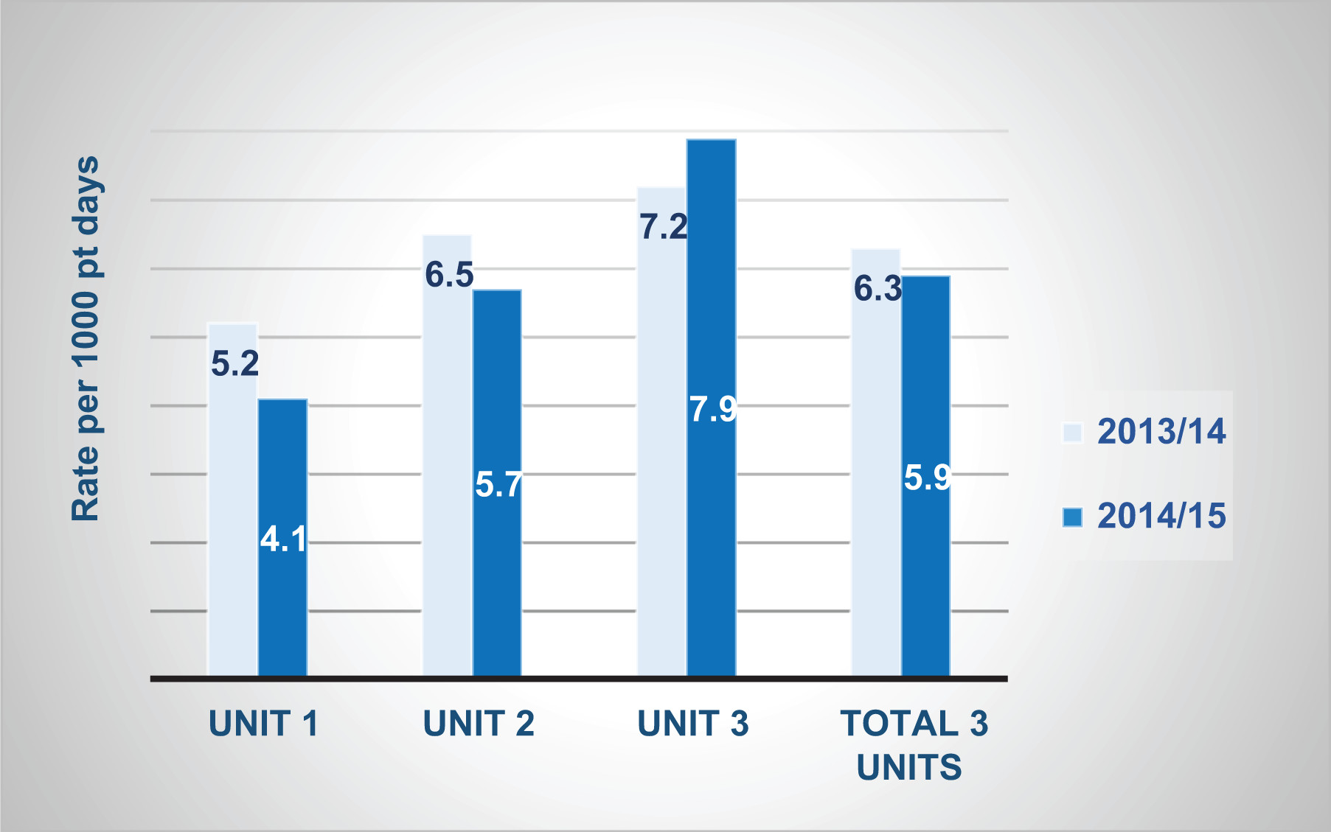
Hourly Rounding and Fall prevention-
A Review of Studies
Dana D. Rohrbaugh, RN
Fort Hays State University, Department of Nursing
Introduction
Patient falls cause physical and psychological harm to patients, increase healthcare costs related to injuries and increased lengths of stay, and may lead to legal settlements costing millions of dollars (Chu, 2017). Costs from preventable patient falls are not reimbursed by the centers for Medicare and Medicaid Services (2016) and hospitals must absorb these costs. Cause of falls can be categorized as problems with nursing staff, patient and family, equipment, environment, and the organization or system (Stoeckle, Iseler, Havey, & Abersold, 2018).
Hospitals rely on fall risk assessments and fall prevention bundles including signs and identifying wrist bands, non-slip footwear, bed alarms, ensuring clear floors and adequate lighting. Purposeful hourly rounding has been added to the standard bundle to prevent falls.
Research Question
Purpose
One of the more recent additions to the patient fall prevention toolbox is the use of nurse hourly rounding. Given the efficiency pressures on a nurse's time, does adding hourly rounding significantly reduce patient falls?
Conceptual Framework
The basic underlying principle for this systematic review of literature comes from the Neuman's system model (Dewan & Ume-Nwagbo, 2006). The patient is the primary system and responds to stressors, attempting to maintain stability. In this systems model prevention and risk reduction are the primary interventions. Secondary prevention manages symptoms in response to stressors, attempting to reduce noxious effects, and tertiary prevention includes the patient's adjustment as they heal and maintain health. Fall and injury prevention is applicable in each level.
Implications for Nursing
Although a statistically significant difference was not found in all studies, most studies did show a decrease in falls associated with purposeful nurse rounding. Any decrease in falls benefits patients, nurses, and organizations by preventing injury and associated costs. Hourly rounding is simple and inexpensive to implement, can lead to better nursing care and improved patient outcomes.
Methods
The current study examined six peer reviewed research articles between 2015 and 2020 that used a pre/post methodological approach in acute care settings. The preconditions included the use of various primary fall prevention methods like fall risk assessment, patient education, nonslip socks, and others. The post conditions included the addition of nurse purposeful hourly rounding with some institutions increasing education and standard fall prevention efforts.
In all studies pre-implementation data was drawn from hospital patient records. Post-implementation data included hospital patient records plus purposeful rounding reports (Zadvinskis et al. 2019, Maddigan, Butler, & Davidson, 2019), a measure of quality characteristics (Kuwaiti & Subbarayalu, 2017), and rounding completion measurements (Goldsack, Bergey, et al., 2015). The implementation phase in all studies included various forms of purposeful nurse rounding training ranging from 30 days to nine months (Grille, Firth, & Hatch 2019, Rim, Semanik, & Miller, 2019).
The pre and post-implementation data collection periods were not identified in all studies. Reporting studies ranged from 30 days to a year. Three of the studies covered single hospital units and three studies covered multiple hospital units.
Purposeful Hourly Rounding Components
Pain- assess pain and relief methods
Position – assist patients to reposition
Potty- help patients to toilet
Possessions- ensure patient can reach
belongings, including call bell
Pumps- ensure equipment if functioning
correctly and not in patient's way
Results
Although hourly nurse rounding has been shown to have an impact along with other fall prevention actions, current studies provide no clear indication that purposeful rounding will always reduce patient fall rates.
Figure 1 below comes from one of the multi-unit studies and is representative of this overall review. Results across studies varied with two studies indicating a statistically significant reduction in fall rates, two studies indicated a reduction in fall rates that was not statistically significant, one multi-unit study (Zadvinskis, et al. 2019) had reduction of falls on units with fewer nurses and an increase in falls on units with more nurses, and the study below with two units showing non-significant reductions and one unit with an increase in falls.
The results of the current study were similar to Hicks (2015) review that reported ten studies with decreases in falls, three that were not statistically significant, and four studies that showed no change in fall rates.
References
Centers for Medicare and Medicaid Services. (2016). Hospital-acquired conditions (present on admission indicator). Retrieved from http://www.cms.hhs.gov/HospitalAcqCond/06_Hospital-AcquiredConditions.asp#TopOfPage
Chu, R, Z., (2017) Preventing in-patient falls: The nurse's pivotal role Nursing 47(3) doi: 10.1097/01.NURSE.0000512872.83762.69
Centers for Medicare and Medicaid Services. (2016). Hospital-acquired conditions (present on admission indicator). Retrieved from http://www.cms.hhs.gov/HospitalAcqCond/06_Hospital-AcquiredConditions.asp#TopOfPage
Dewan, S. A., & Ume-Nwagbo, P. N. (2006). Using the Neuman Systems Model for Best Practices, Nursing Science Quarterly, 19(1) 31-35. doi: 10.1177/0894318405284125
Goldsack J, Bergey M, Mascioli S, & Cunningham J. (2015). Hourly rounding and patient falls: what factors boost success? Nursing, 45(2):25-30. doi: 10.1097/01.NURSE.0000459798.79840.95.
Grillo, D., Firth, K., & Hatchel, K. (2019). Implementation of Purposeful Hourly Rounds in Addition to a Fall Bundle to Prevent Inpatient Falls on a Medical-Surgical Acute Hospital Unit. MedSurg Nursing, 28(4), 243-246,261. Retrieved from http://search.ebscohost.com.ezproxy.fhsu.edu: 2048/login.aspx?direct=true&db=c8h&AN=138187887&site=ehost-live&scope=site.
Rima, K., Semanik, P., & Miller, J., (2019). Midwest Nursing Research Society Winning Abstracts. Western Journal of Nursing Research, 41(11), 1685-1702. doi: 10.1177/0193945919857712
Hicks, Darlene. (2015). Can rounding reduce patient falls in acute care? An integrative literature review. MedSurg Nursing, 24(1), 51-55. Retrieved from https://search-proquest-com.ezproxy.fhsu.edu/docview/1655503487?accountid=27424
Kuwaiti, A., & Subbarayalu, A. (2017). Reducing patients’ falls rate in an Academic Medical Center (AMC) using Six Sigma “DMAIC” approach. International Journal of Health Care Quality Assurance, 30(4), 373-384. doi:10.1108/IJHCQA-03-2016-0030
Maddigan, J., Butler, M., & Davidson, J. (2019). Changing nursing practice: Implementation challenges of intentional rounding on three rehabilitation units. Healthcare Management Forum, 32(5), 237-241. doi: 10.1177/0840470419849612
Zadvinskis, I. M., Carr, J. E., Schweitzer, K. D., Patil, N., Clifton, W., & Ebert, K. (2019). The Impact of Nursing Work and Engagement on Patient Falls. JONA: The Journal of Nursing Administration, 49(11), 531-537. doi: 10.1097/NNA.0000000000000808
Among patients in an acute setting, does hourly rounding enhance the efficacy of a standard fall prevention bundle over a standard fall prevention bundle alone?
Figure 1: Annual fall rates by unit DOI: (10.1177/0840470419849612)

