Slide 1
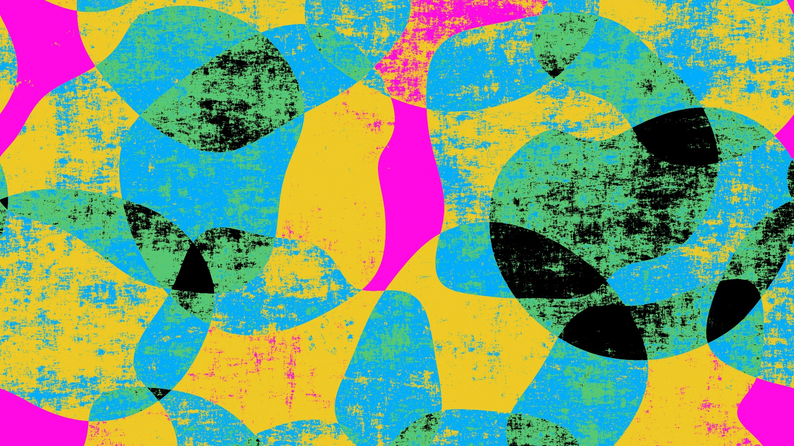
Being Social to Relieve Stress
David Ketron

Slide 2
What we know now
As of today, due to the current pandemic causes great changes to what people have done in the past. Ex. Handshakes, High fives, and ect.
Thanks to social distancing and the added precautions has cause great amounts of stress to the people. Myself included.

Slide 3
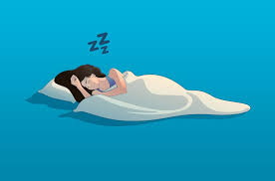
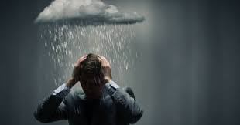
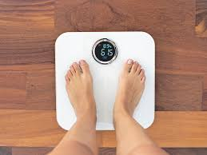
Effects of stress
Going through these stressful situations and cause many forms of problems both physically and psychologically in the forms of:
Lose/gain of weight (depending of individual)
Lower amounts of sleep
Suicidal thoughts

Slide 4
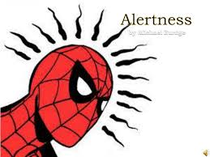
Benefit of stress
Keeps us alert from any incoming dangers.

Slide 5
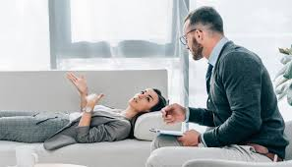
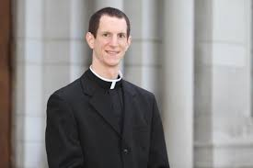
Always ask for help
The current pressures in life and take its toll to an individual.
Go talk to a psychologist or your local priest or pastor about how you are feeling. They may have knowledge to help get through the situation that you maybe in.

Slide 6
Stay strong
Everyone has gone through a considered number of rough days and this pandemic is no different we as people is persevere and no matter what asking for help is not considered a weakness.
As the saying goes teamwork makes the dream work.

