Slide 1
Corona Virus and Financial Impacts of History
By
David Ketron

Slide 2
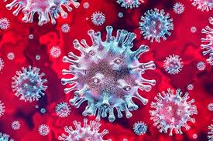
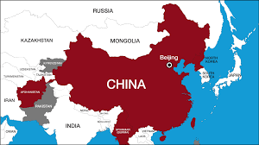
Corona Virus
As we know today that the Corona virus has caused an impact on everyone in the world and to the economy.
This virus itself is made by China and during/before winter the virus was released.
It spread through Asia and then to the world which cause people close businesses making an impact in the economy.

Slide 3
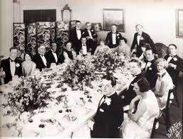
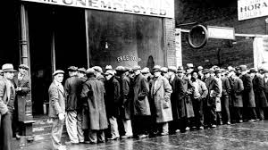
Great Depression
The Great depression started in the end of the roaring 20’S
Many companies and businesses were shutdown.
Many who were once rich became poor beggars out in the streets.

