Slide 1
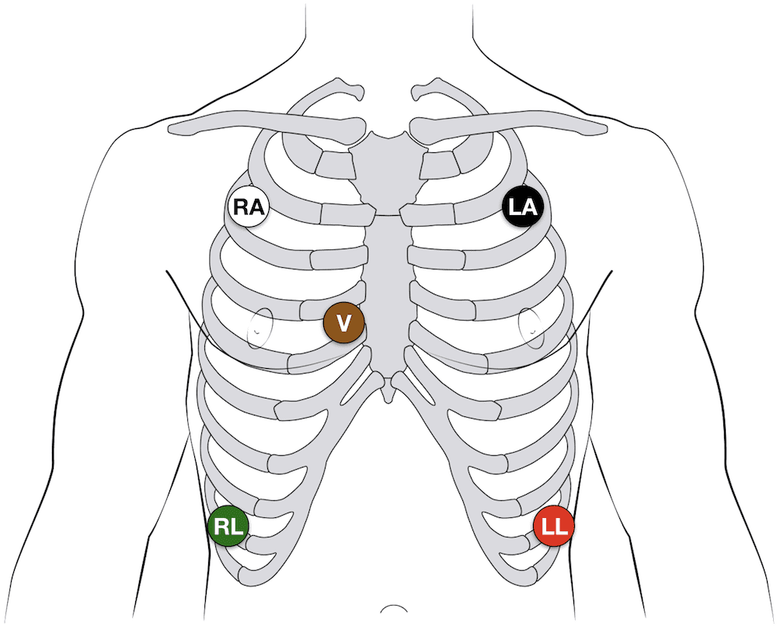
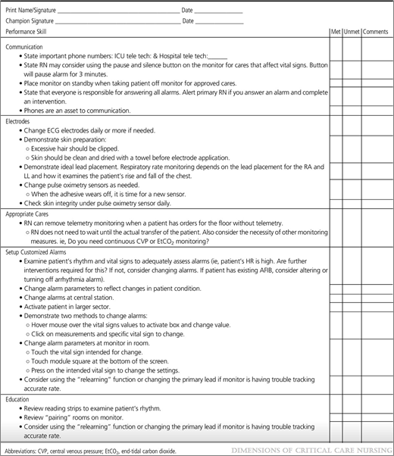
Alarm Fatigue, a very real nursing phenomenon!
Andrea Rountree RN, FHNS
Nursing Inquiry for the RN, NURS 446
Fort Hays State University, Department of Nursing
Introduction
Alarm fatigue is a very real phenomenon for nursing staff in many hospital settings. This can lead to desensitization of nursing staff to respond to patient's needs.
Methods
The number of auditory monitoring alarms was counted. The duration of an alarm was measured in seconds and was the time elapsed from the start and stop time. Start time was when the alarm initially began, and end time was when the alarm was recorded to have stopped on the download from the monitoring system. The ICU/SDU staff nurse perception of alarm fatigue was measured by the Healthcare Technology Foundation Clinical Alarms Survey (Lewis, 2019). Education was provided on proper lead placement see Fig A. Checklists were provided to ensure proper use of CEASE see Fig B.
Nursing Implications
Alarm fatigue is very real problem. While monitoring is essential for patient care, when the monitors seem to alarm for absolutely no reason nursing staff tends to unintentionally ignore these alarms, thus ignoring patient needs. Accurate monitoring would improve alarm fatigue and would improve patient outcomes.
References
Aysha, Z., & Ahmed, S. (2019, August 01). The Effect of Implementing Clinical Alarm Nursing Intervention Program on Nurses' Knowledge, Practice and Patient Outcomes at Intensive Care Unit.Retrieved July 21, 2020, from http://www.sciepub.com/AJNR/abstract/10788
Cho, O., Kim, H., Lee, Y., & Cho, I. (2016, January). Clinical Alarms in Intensive Care Units: Perceived Obstacles of Alarm Management and Alarm Fatigue in Nurses. Retrieved July 21, 2020, fromhttps://www.ncbi.nlm.nih.gov/pmc/articles/PMC4756058/
Gaines, B. (2019, August 19). Alarm Fatigue is Way Too Real (and Scary) For Nurses. Retrieved July 18, 2020, from https://nurse.org/articles/alarm-fatigue-statistics-patient-safety/
Lewis, C. (2019). Research Outcomes of Implementing CEASE: An Innovative,... : Dimensions of Critical Care Nursing. Retrieved July 18, 2020, from https://journals.lww.com/dccnjournal/Fulltext/2019/05000/Research_Outcomes_Of_Implementin CEASE_An.9.aspx
R;, W. (2019, September 3). Alarm Fatigue: Using Alarm Data from a Patient Data Monitoring System on an Intensive Care Unit to Improve the Alarm Management. Retrieved July 21, 2020, from https://pubmed.ncbi.nlm.n
Wayne, G. (2020, January 02). Nursing Theories and Theorists: An Ultimate Guide for Nurses. Retrieved July 20, 2020, from https://nurseslabs.com/nursing-theories/
Research Question
In acute inpatient telemetry units, what is the effect of a nurse-driven patient monitoring bundle on alarm fatigue compared to no monitoring bundle?
Purpose
Describe the effect of implementing CEASE, a nurse-driven, evidence-based, patient-customized monitoring bundle on alarm fatigue in ICU's and SDU's (Lewis, 2019).
Results
- Total number of auditory monitor alarms decreased 30.45% from 52,880 to 36,780.
The number of Level 1 auditory monitor alarms decreased 7.7% from 14,131 to 13,040. The number of Level 2 auditory monitor alarms decreased 39.35% from 31,251 to 18,955. The number of Level 3 auditory monitor alarms decreased 36.18% from 7498 to 4785. Nurses perceived a significant decrease in nuisance alarm occurrence (Lewis, 2019).
Fig A.
Fig B
Conceptual Framework
Hildegard Peplau's theory states “An interpersonal process of therapeutic interactions between an individual who is sick or in need of health services and a nurse especially educated to recognize, respond to the need for help. ” This helps nurses and healthcare providers develop more therapeutic interventions in the clinical setting (Wayne, 2020).
This Photo by Unknown author is licensed under CC BY-SA-NC. CEASE electrode placement.

